Slide 1
Autonomous VEHICLE project
ELECTRONIC ENGINEERING 19/20
MICROCONTROLLERS
MEMBERS:
ENKELEDI MEMA
YAHIA MESHARAF
KRISTINA BALA

Slide 2
Project Components
-Car wooden prototype
-Arduino and Sensors
-RaspberryPi and Camera
-User Interface and Video Streaming

Slide 3
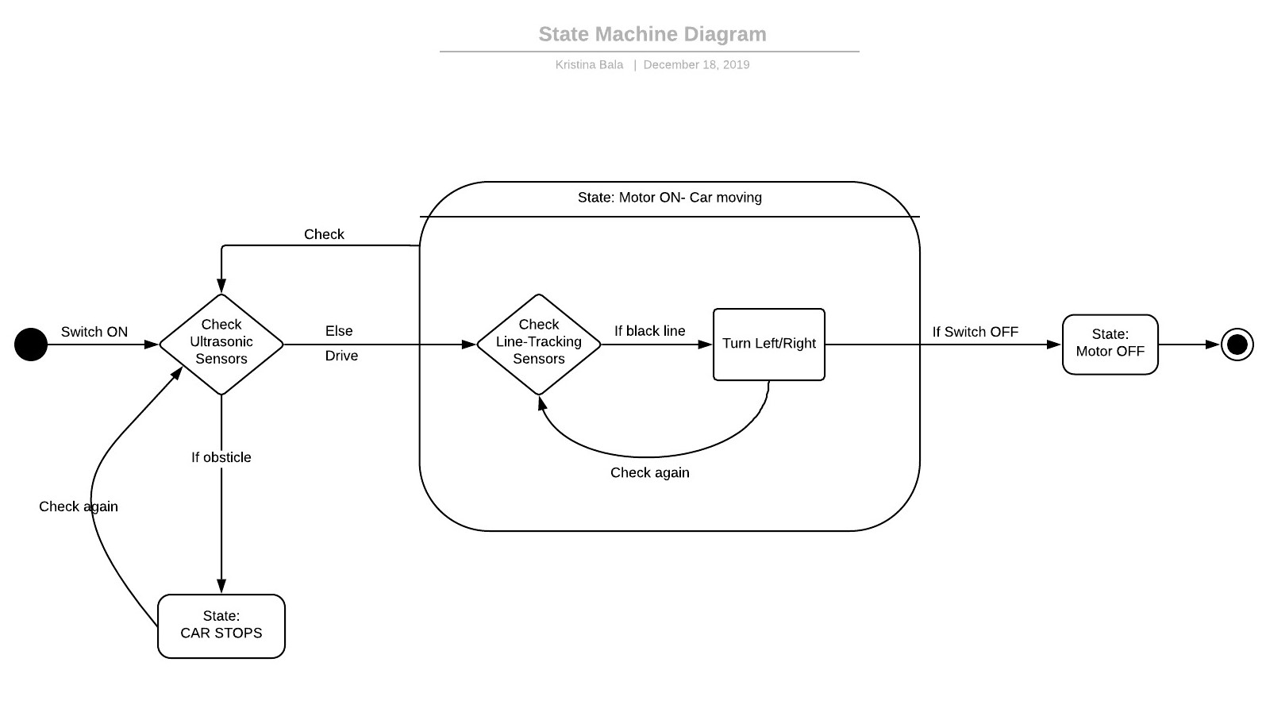

Slide 4
Future Improvements
-Connecting the parts of the system
-Implementing the Qt functionality to the vehicle
-Communication with image processing

